Slide 1
MATT Prototype
By Kumar Laxmikant

Slide 2
Project objective
Accurate Sound Representation
Realistic User Interface
Remote connectivity
System independent Software
Compatibility and Portability
Interactive Learning
Educational Content - Personalised Learning
Customization Options

Slide 3
Dataset - Sound
Heart
Lungs
Bowel
Korotkoff
(40 Sounds)
(18 Sounds)
(14 Sounds)
(5 Sounds)
Location:
Mitral Valve
Aortic Valve
Pulmonary Valve
Tricuspid Valve
Erb’s Point
Location:
Left Upper Lobe
Left Middle Lobe
Left Lower Lobe
Location:
Left Upper Quadrant
Left Lower Quadrant
Right Upper Quadrant
Right Lower Quadrant
Location:
No Locations specified
Right Upper Lobe
Right Middle Lobe
Right Lower Lobe
Acute myocardial infarction
Acute pericarditis
Aortic stenosis & regurgitation
Aortic valve regurgitation
Aortic valve stenosis
Atrial septal defect
Austin flint murmur
Coarctation of the aorta
Congestive heart failure
Continuous murmur
Diastolic murmur
Dilated cardiomyopathy
Early systolic murmur
Fourth heart sound gallop
Functional murmur
Holosystolic murmur
Hypertrophic cardiomyopathy
Mid-systolic murmur
Mitral stenosis & regurgitation
Mitral stenosis & tricuspid regurgitation
Mitral valve prelapse
Mitral valve regurgitation
Mitral valve stenosis
Normal heart
Opening snap
Patent ductus arteriosus
Pericardial rub
Pulmonary hypertension
Pulmonary valve regurgitation
Pulmonary valve stenosis
Split first heart sound
Split second heart sound
Stills murmur
Systemic hypertension
Tetralogy of fallot
Third heart sound gallop
Tricuspid valve regurgitation
Ventricular aneurysm
Ventricular septal defect
Amphoric respiration
Bronchial respiration
Bronchovesicular respiration
Coarse crackles
Diminished vesicular respiration
Fine crackles
Gurgling rhonchi
Harsh respiration
Pleural friction rub
rhonchi
stridor
Vesicular respiration
wheezes
asthma
covid-19
Tapping Swishing Knocking Muffling Silent
borborygmus
Bruits due to renal arteries stenosis
capotement
constipation
Crohns disease
diarrhea
Hyperactive sounds
Hypoactive sounds
Irritable bowel syndrome
Normal bowel
Normal bowel sound with bruits
Paralytic ileus
Peritoneal friction rub
Ulcerative colitis

Slide 4







Technology Used - Software
Front-End
Framework
Database
Back-End

Slide 5
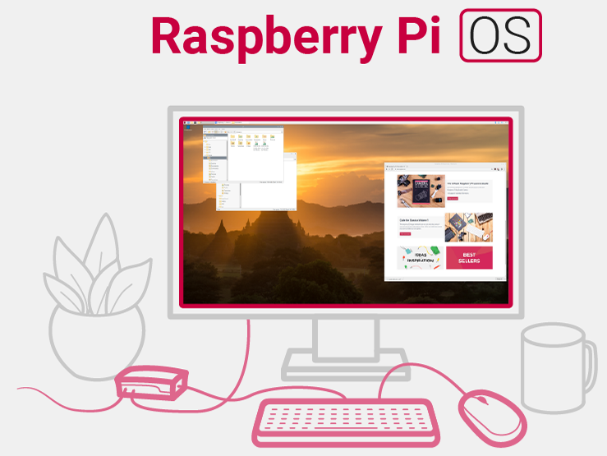

Technology Used - Operating System
Raspberry Pi OS (Legacy, 32 bits) A port of Debian Bullseye with security updates and desktop environment

Slide 6
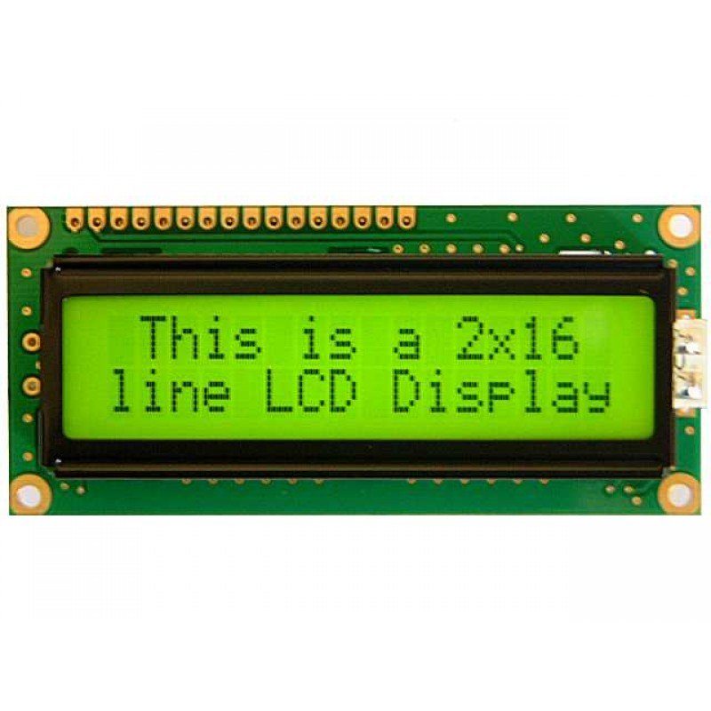
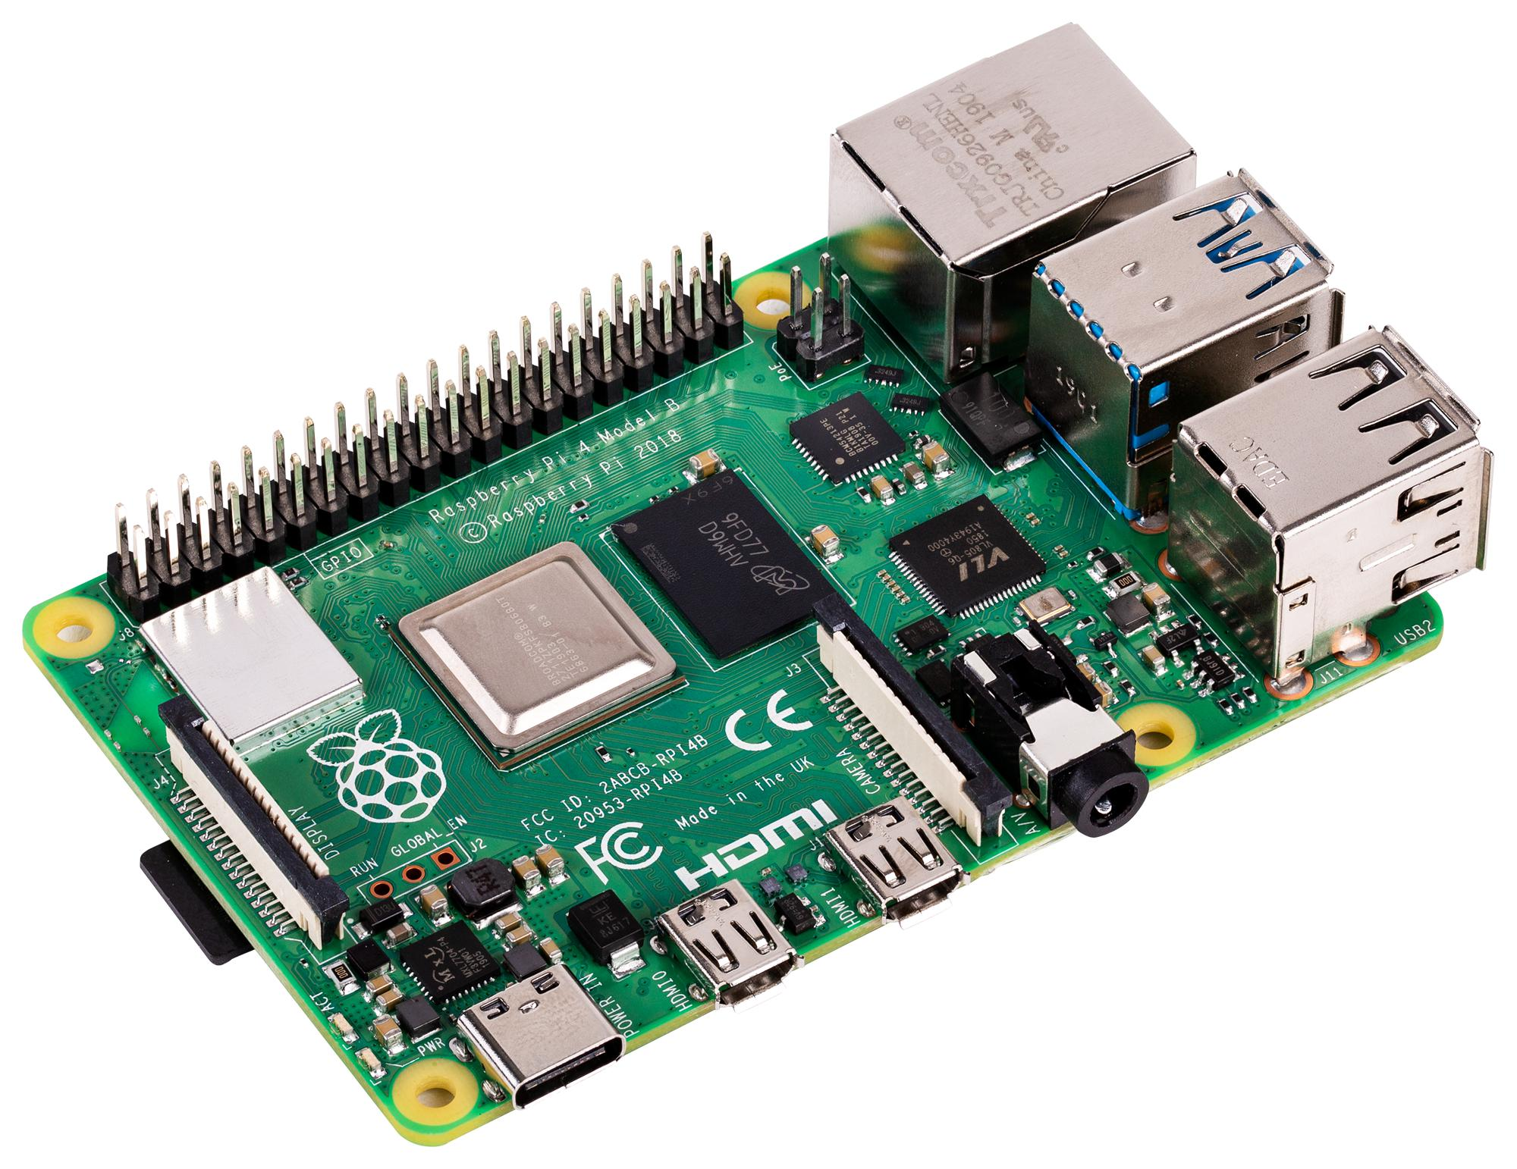
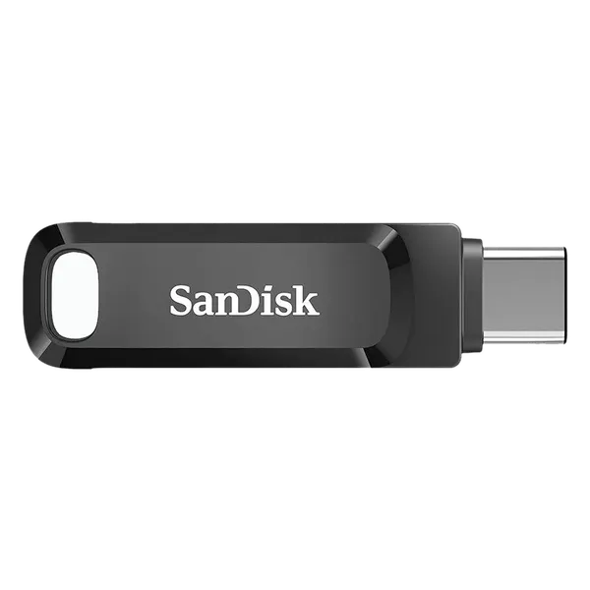
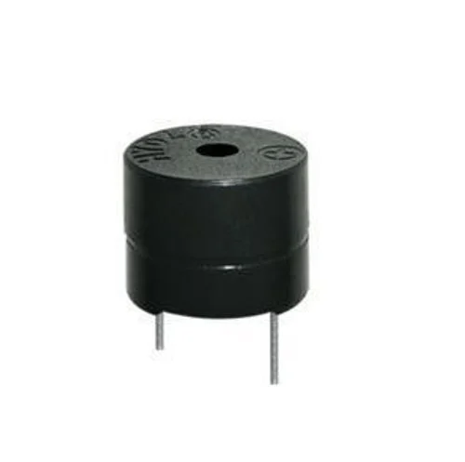
Technology Used - Hardware
16x2 LCD Display
Raspberry Pi 4 Model B
Bootable USB SSD
Buzzer

Slide 7
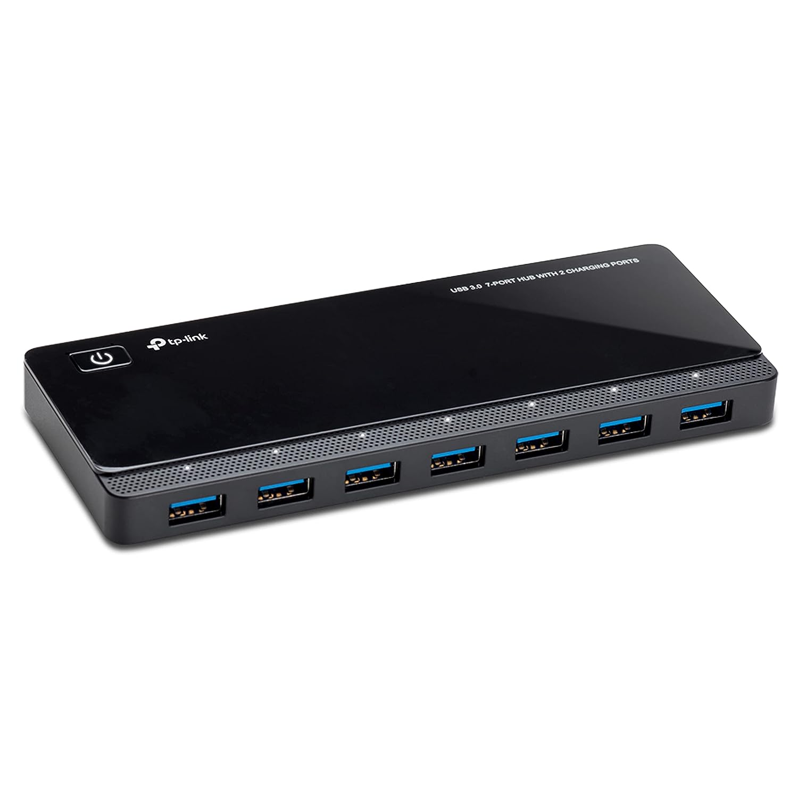
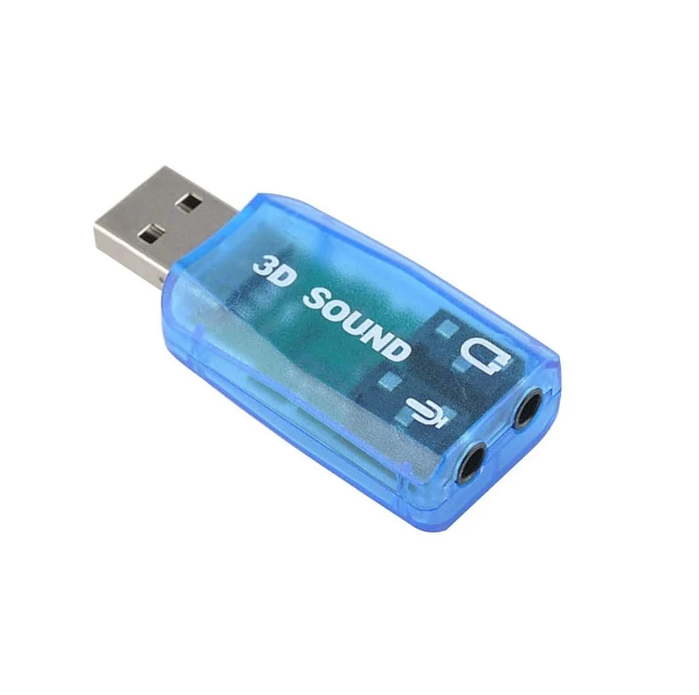
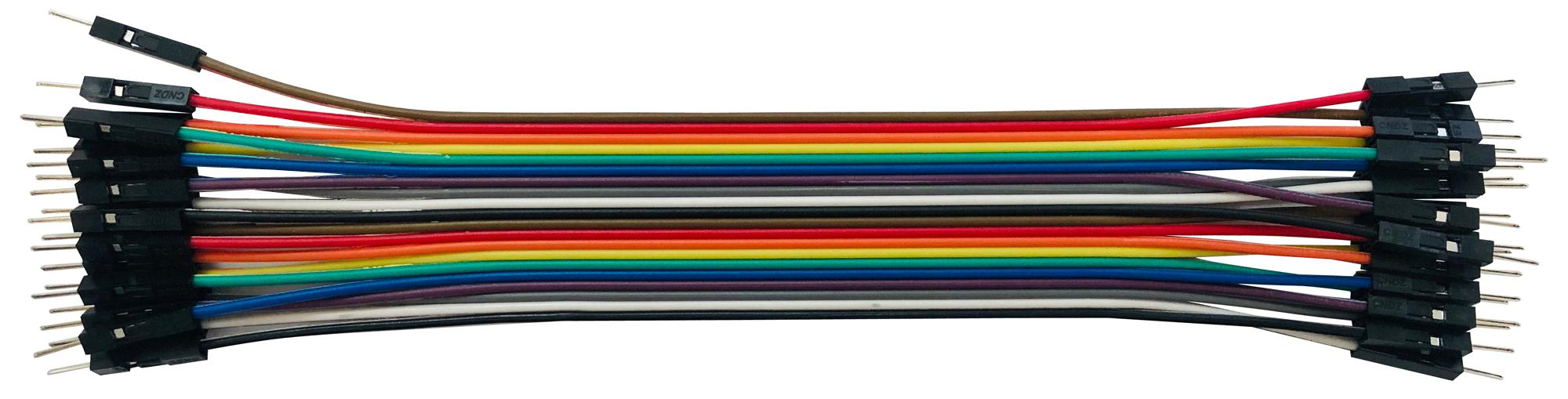
Technology Used - Hardware
USB 3.0 7-Port Hub
5.1 channel USB Sound Card
Jumper Wire

Slide 8

Pinout Diagram - Raspberry Pi 4 Model B

Slide 9
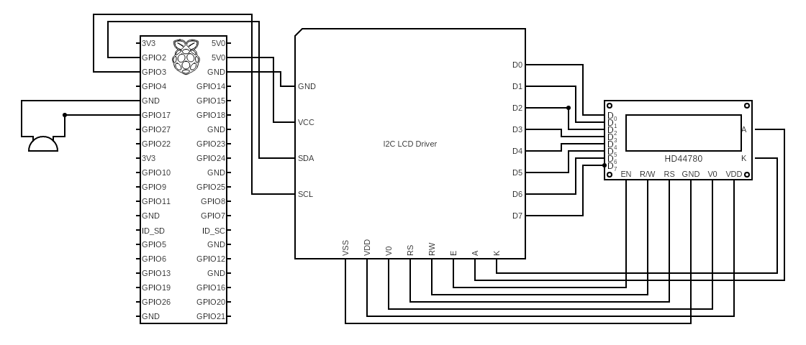
Circuit Diagram

Slide 10
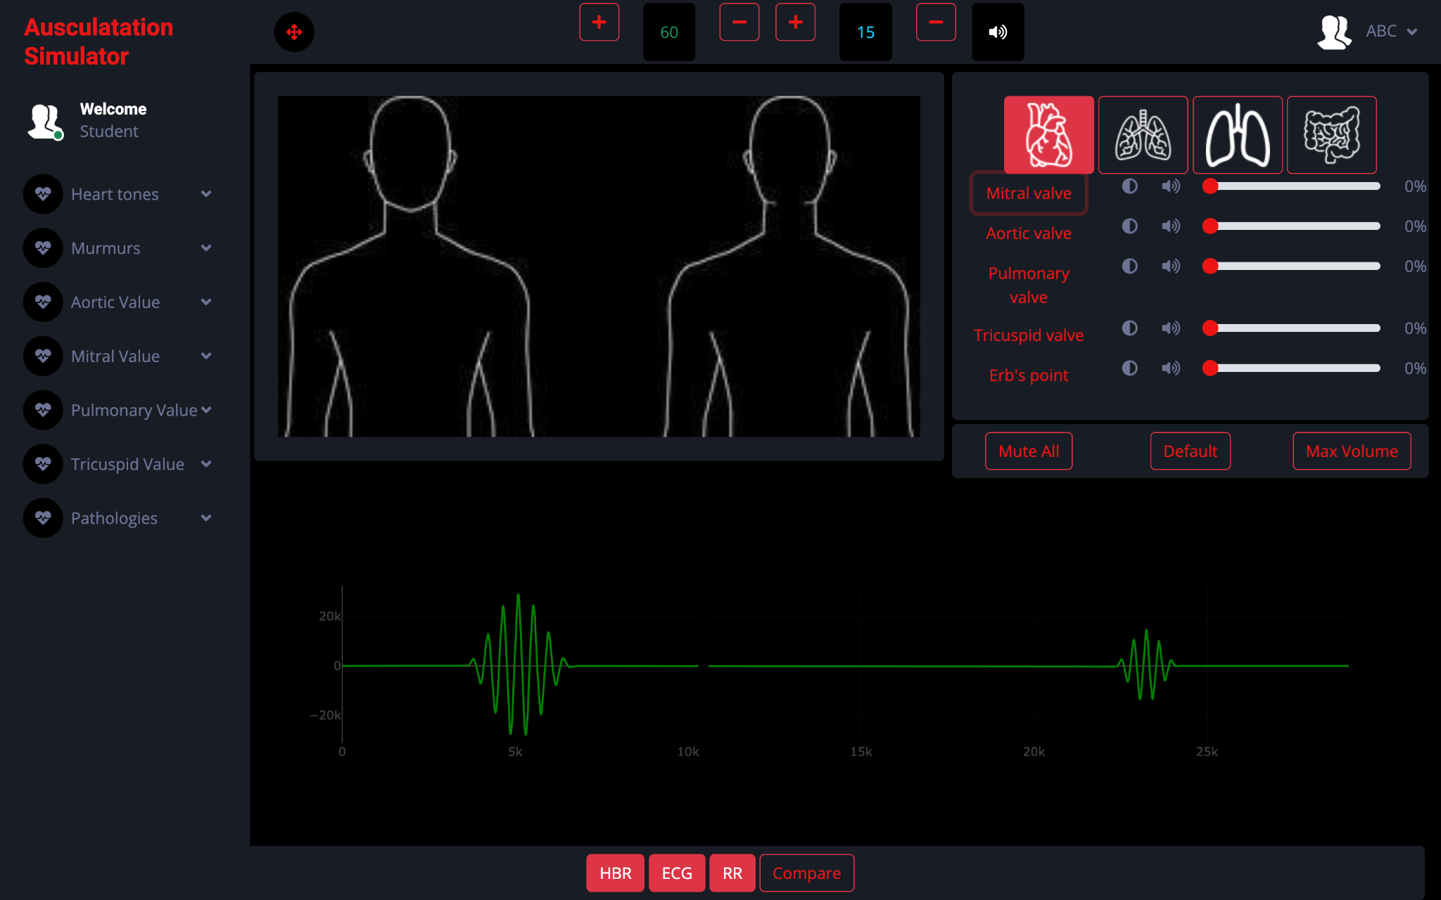
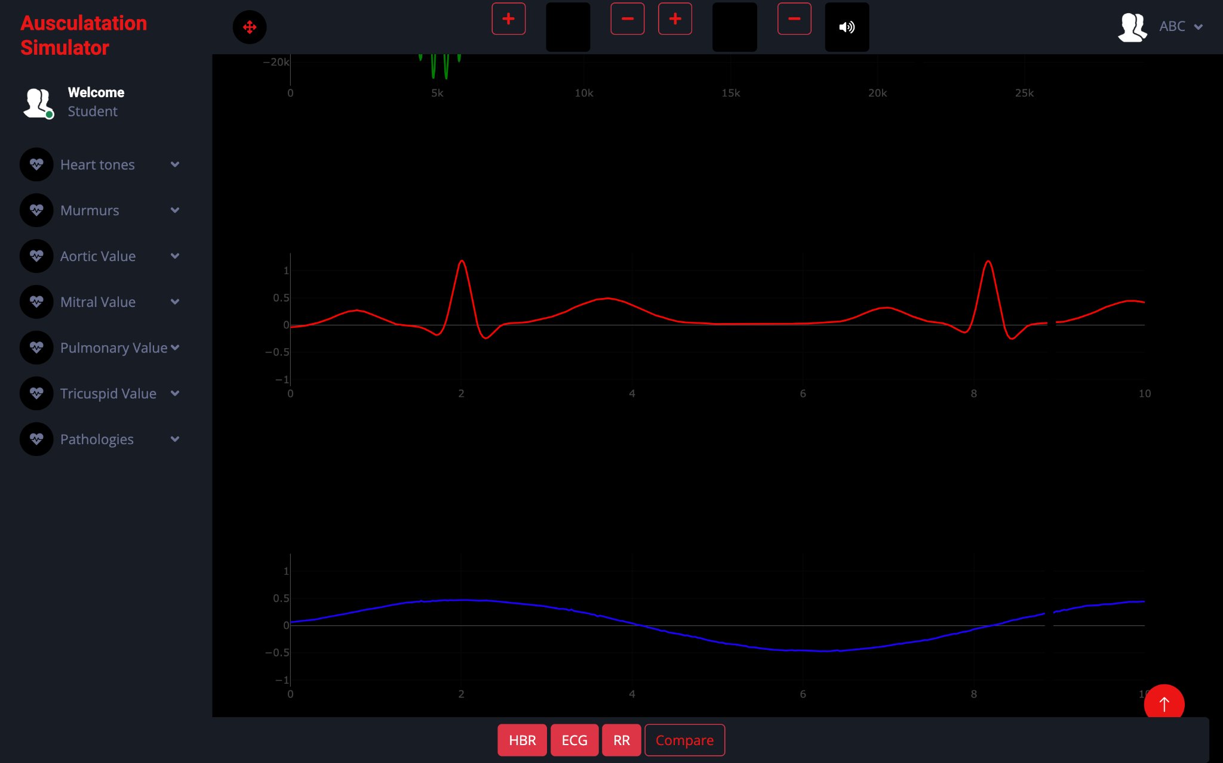
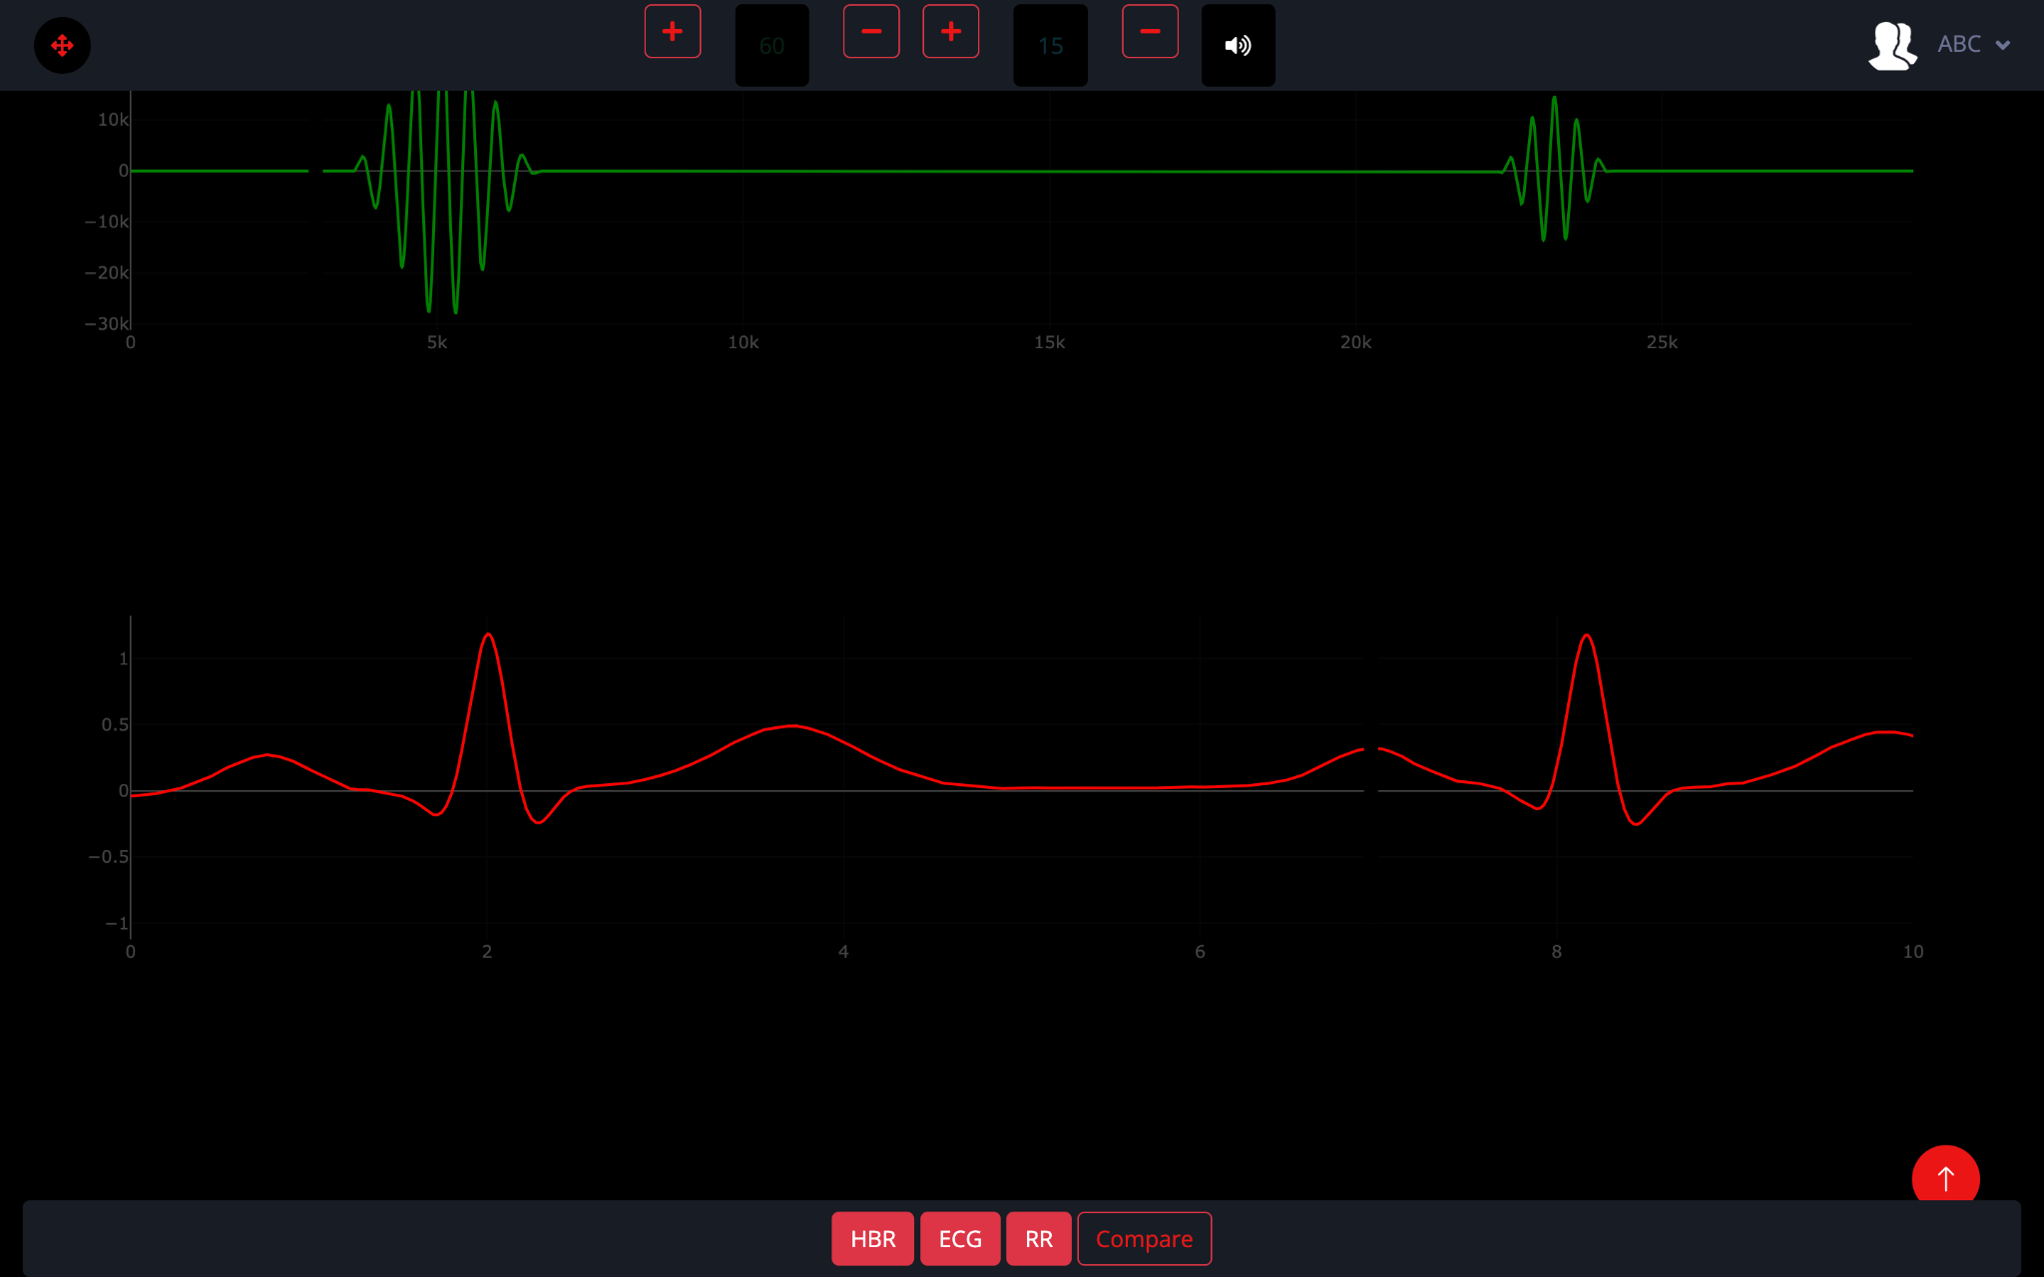
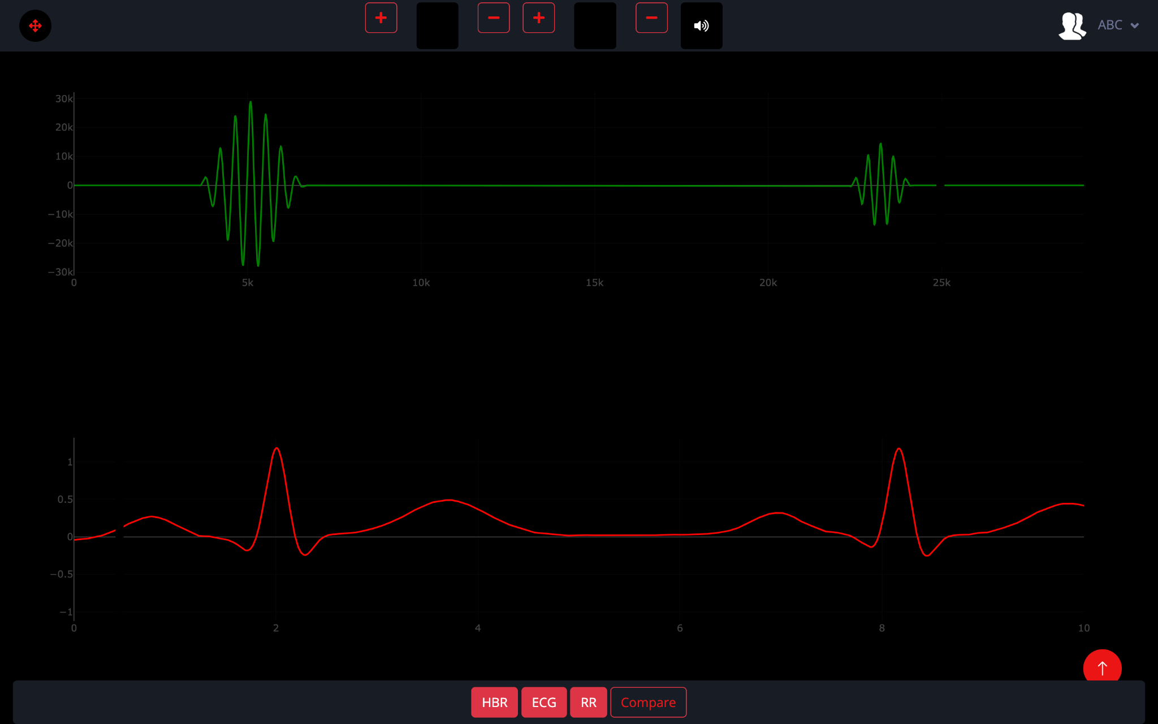

Slide 11
Feature: Adaptive UI

Slide 12
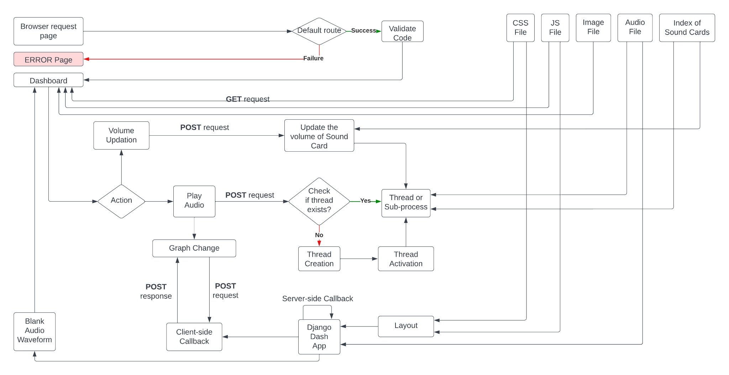
Flow Diagram
Web Browser/user
Server
Static Resources

Slide 13
Project timeline
Backend Configuration
Backend completed
Communication channel initiation
Raspberry Pi’s wireless configuration completed
Audio testing completed
Project Initiation
Collected Audio Dataset
Tech stack finalization
Theme finalization
Jan
March
Feb
UI Completion
Front End completed
Back End initiation
Raspberry Pi setup initiation
Audio testing initiation
Raspberry Pi Configuration and documentation
Communication routes setup
Documentation initiated
Full Stack application configured in Raspberry Pi

Slide 14
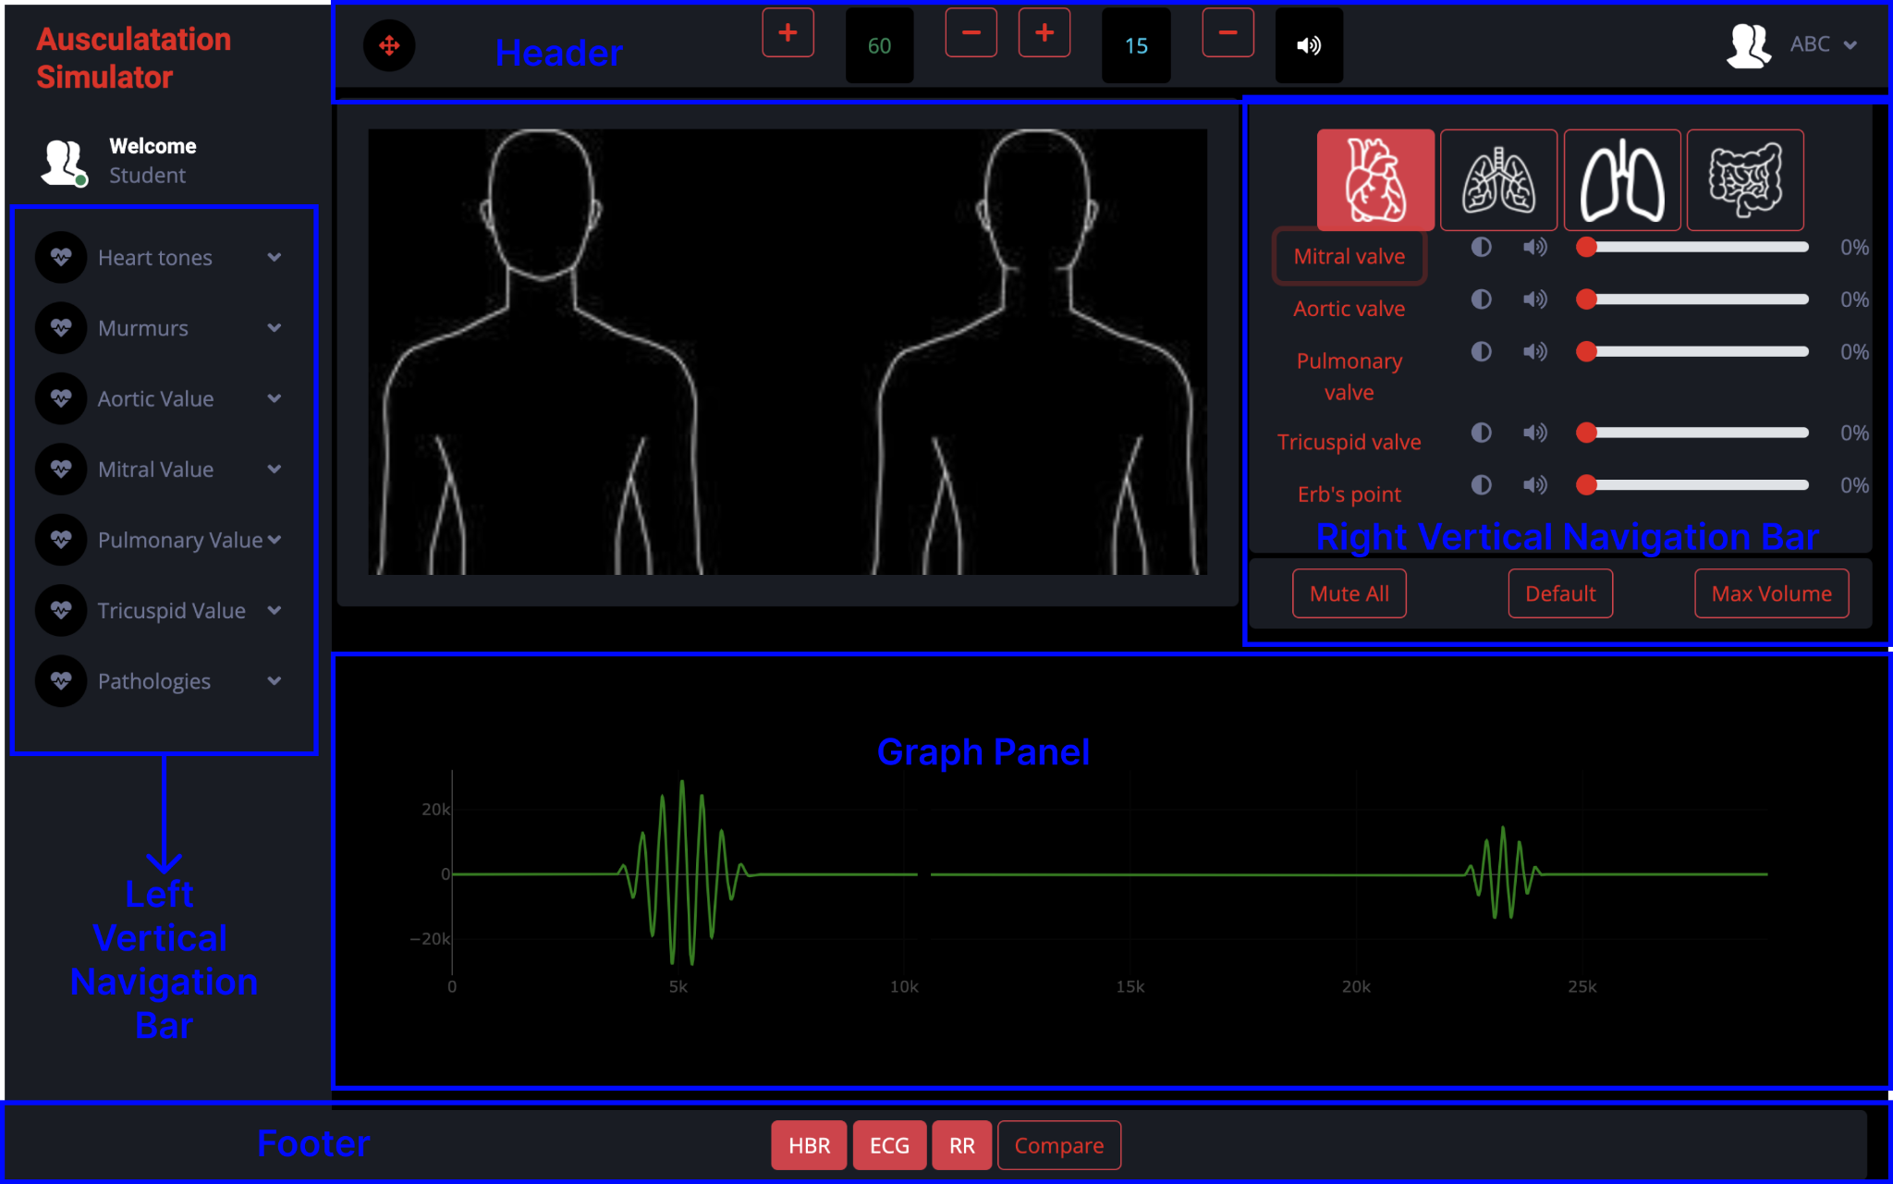
UI Components

Slide 15
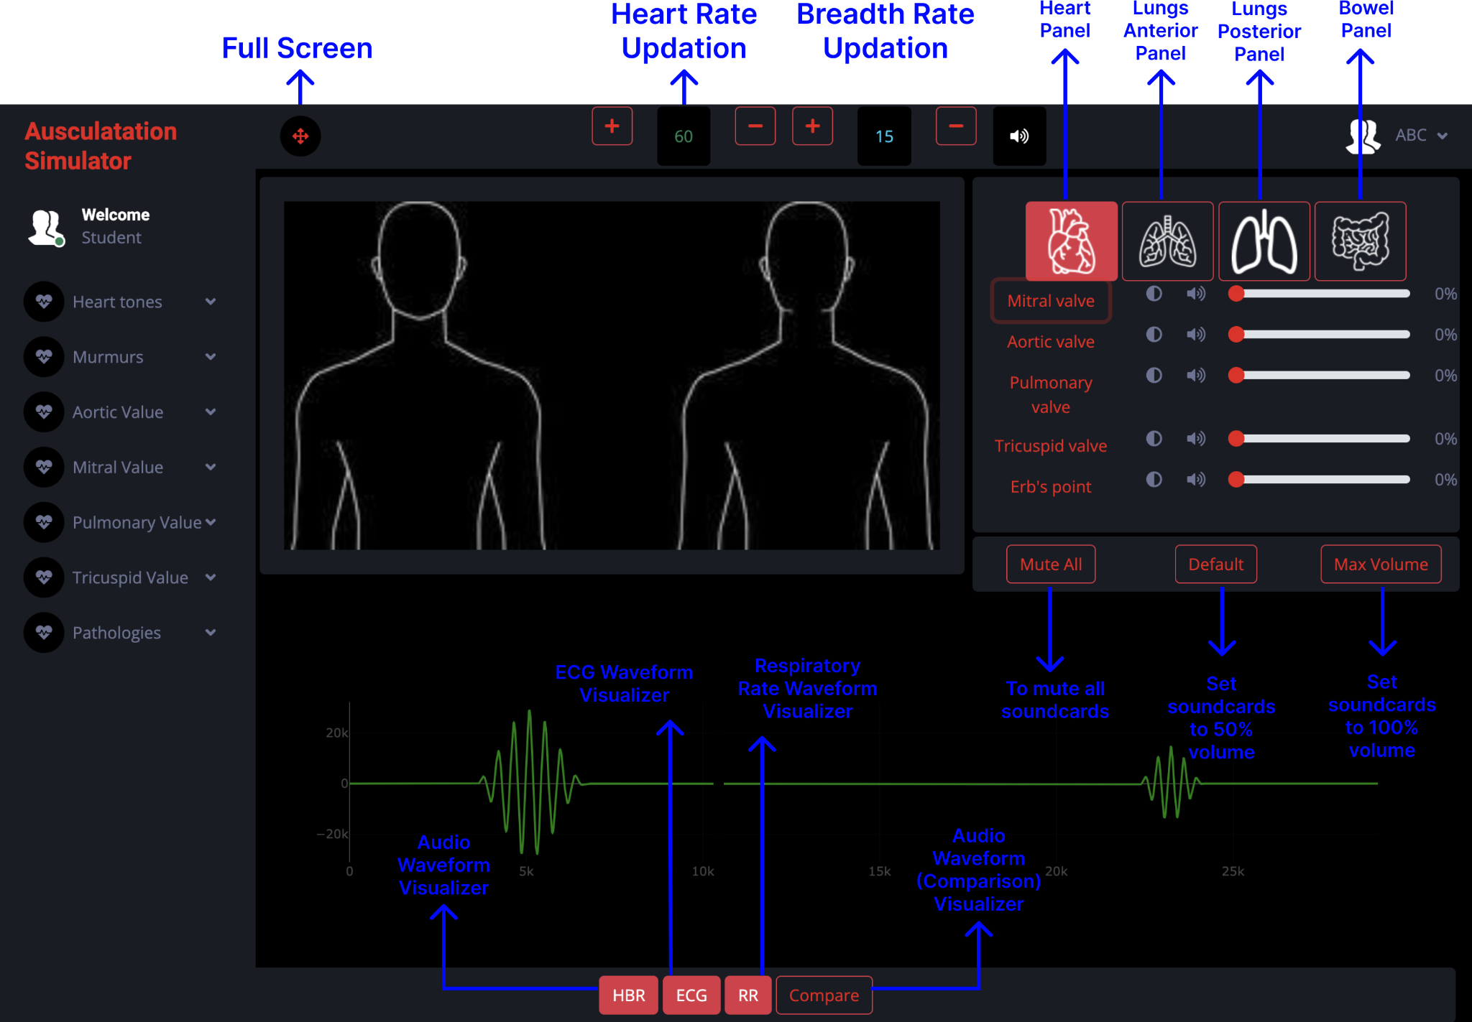
UI Components

Slide 16
Future Works
01
Custom Audio Adapter: The proposed custom audio adapter board features multiple aux ports with individual gain control and audio mixing capabilities for a versatile and personalized audio experience.
02
Optimizing Graph Rendering: Future plans could involve implementing a new client-side module to accelerate graph rendering and updates, ensuring a faster and more responsive display.
03
Enhancing Security Measures: In future developments, a key focus will be on fortifying the application's security by incorporating robust cybersecurity features, enhancing protection against potential threats and ensuring user data integrity.
04
Towards Seamless Connectivity: In the upcoming updates, the application could be enhanced to provide live updates across multiple connected devices, preventing resource deadlocks and ensuring a seamless user experience.

Slide 17
Thank you!

